Slide 1


Practical Approach to Severe Hypertension
Sarah Taaghi MD
Cardiovascular specialist
Assistant professor of Cardiology
IUMS – Rasoul Akram Hospital

Slide 2
CASE 1
64 y/o female patient presented to the ED due to severe headache and blurred vision.
Her initial BP : 150/95 mmHg

Slide 3
Now we face some important questions:
Reduce BP ?
If yes : How much?
How rapid?
Which drug?
Admit her ?
In which ward?
When to start oral medications?

Slide 4
Emergency VS Urgency

Slide 5
Hypertension emergency
Increased BP ( any level!) with HMOD
HMOD : HTN mediated organ damage

Slide 6
Target organs :
Retina → papilledema , hemorrhage , cotton wool spots
Brain→ Encephalopathy, Ischemic stroke , Hemorrhagic stroke
Heart →pulmonary edema , ACS
Large arteries → Aortic dissection
Kidneys → AKI

Slide 7
Step 1
Acute, ongoing target-organ damage is present?
If Yes ? :
This is HTN emergency , admit to ICU

Slide 8
Common test
Both arms BP
Fundoscopy
12 leads ECG
CBC , Cr , Electrolytes ,UA
Cardiac biomarkers (if ACS is suspected)
brain CT (if head injury, neurologic symptoms, hypertensive retinopathy, nausea, or vomiting are present)
Aortic CTA or TEE (if aortic dissection is suspected)
Rapid BP lowering need not be delayed in such patients while awaiting the results of imaging

Slide 9
So in our case
Headache
Blurred vision
BP : 160 /100

Slide 10
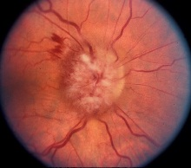

Slide 11
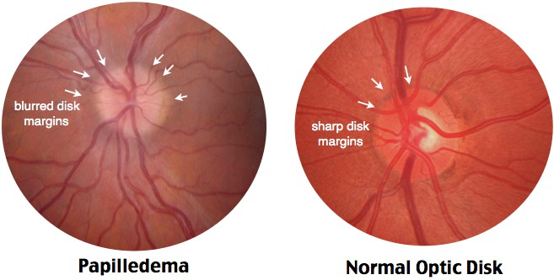

Slide 12
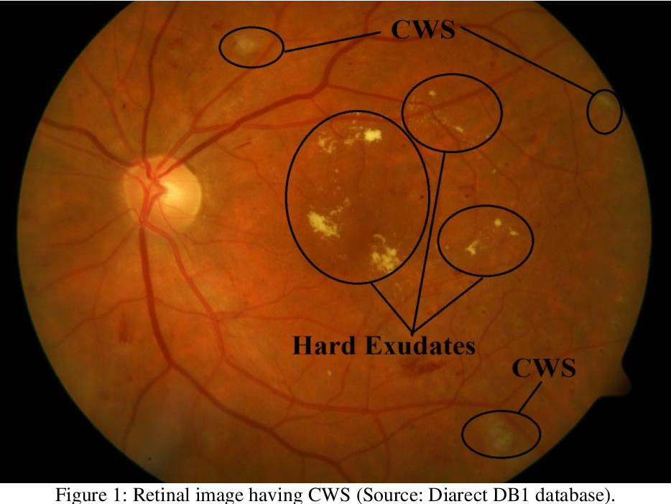

Slide 13
So …
Hypertensive Retinopathy

Slide 14
Step 2
How quickly should the blood pressure be reduced?
What is the blood pressure target during this time period?
Rapid BP lowering to a level below lower limit brain autoregulation may result in CNS dysfunction due to cerebral hypotension

Slide 15
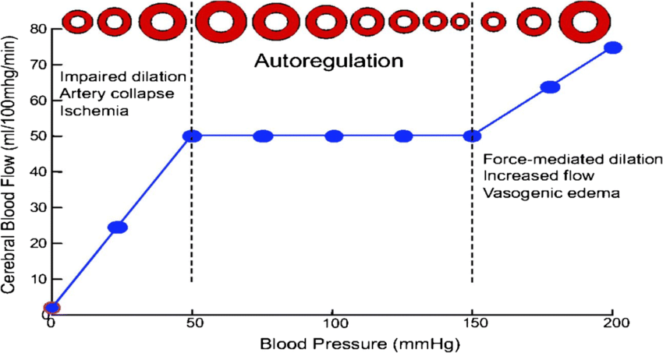

Slide 16
ACC/AHA guidelines 2017
ESC 2018
Reduce max 25 % of MAP in the first hour
Then to 160/110 mmHg over next 2-6 h
Then to the normal over next 24-48 h
MAP : SBP + 2 (DBP) / 3
160 + 200 : 360 /3 : 120
25% : 30 mmHg

Slide 17
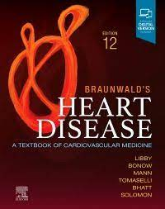
Braunwald’s heart disease 12th edition
Reduce max 10-15 % of MAP in the first hour
A further 10-20 % during the next hour (total 25%)
Initiate oral Tx in the 8-24 h

Slide 18
Step 3
First line treatment ?
It depends on the setting…

Slide 19
In hypertensive crisis with retinopathy
Choice : Labetalol
Alternative : Nitroprusside
Off label : TNG

Slide 20
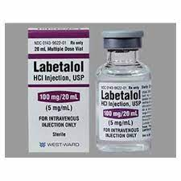
Labetalol
B blocker (1 &2 ) + alfa blocker :
A )
10 - 20 mg over 2 min
Then 20 – 80 mg Q 10 min until goal
B)
  10-20 mg over 2 min
  Then 0.5 – 2 mg/min

Slide 21
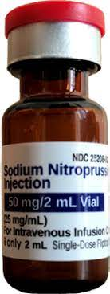
Sodium Nitroprusside
Start : 0.3-0.5 mcg/kg/min
Q 5 min → add 0.5 mcg
Up to 10 mcg/ kg/min ( just for 10 min)
but safe max dose is 2 mcg/Kg/ min

Slide 22
Nitroglycerin : TNG
5 – 10 mcg/min → increase 5 mcg , Q 3-5 up to 20 mcg
If no response →
Increase 10 -20 mcg Q 3-5 up to 200 mcg

Slide 23
So in hypertensive retinopathy
ICU add
Brain CT
Reduce 25 % MAP in 1 – 2 hours
With Labetalol or Nitroperuside
Initiate oral Tx in next 8- 24 h

Slide 24
CASE 2
55 y/o male patient presented to the ED due to weakness and left sided side hemiplegia.
His initial BP was 195/130 mmHg
Fundoscopy and ECG : Normal

Slide 25
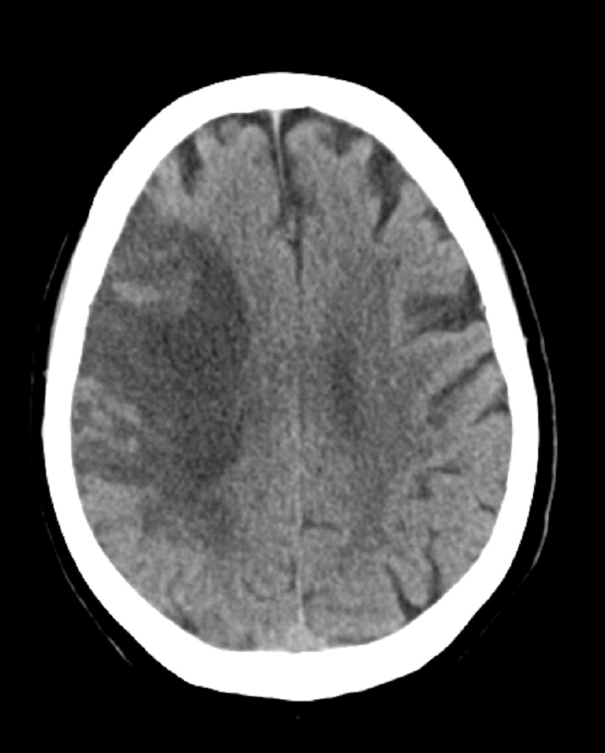

Slide 26
The question is
in the setting of stroke, blood pressure management is just like previous case?

Slide 27
HTN emergency in the setting of ischemic stroke
In general
We do not reduce BP !!!

Slide 28
HTN emergency in the setting of ischemic stroke
If the patient is eligible for thrombolytic :
if SBP >185 and/ or DBP >110 mmHg
Goal : in 1h reduce 15% of MAP

Slide 29
Choice of drug
Choice : Labetalol
Alternative : Nitroprusside

Slide 30
CASE 4
87 y/o female patient presented to the ED due to acute right sided hemiplegia with aphasia.
Her initial BP was 200 /110 mmHg (no significant difference in both arms)
Recent GI bleeding

Slide 31
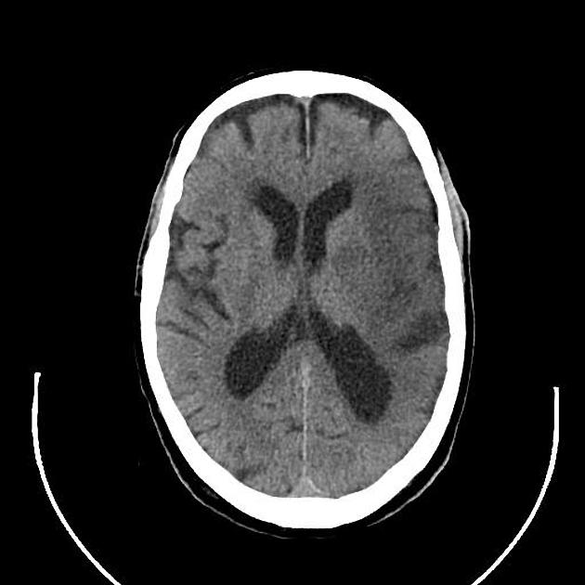

Slide 32
CASE 4
87 y/o female patient presented to the ED due to acute right sided hemiplegia with aphasia.
Her initial BP was 200 /110 mmHg (no significant difference in both arms)
Recent GI bleeding

Slide 33
If the patient is not eligible for rTpa :
  BP should not be treated unless
  SBP > 220 mmHg or DBP > 120 mmHg

Slide 34
What is the logic ?
Protecting ischemic penumbra

Slide 35
CASE 5
50 y/o male patient was referred to the ER due to sudden severe headache , Progressive weakness and decrease in level of consciousness.
He had no other symptoms or history of head trauma.
BP : 230 / 140 mmHg
GCS : 10

Slide 36
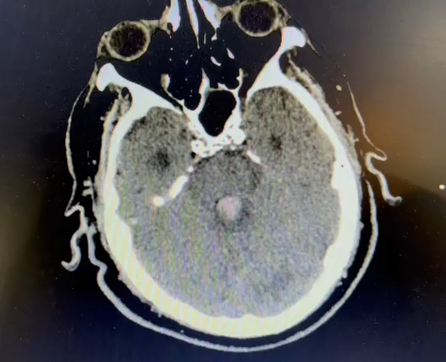

Slide 37
So …
Follow the rule of 25% ?
Or
manage the BP just like ischemic stroke ?
Or ?

Slide 38
Blood pressure management in ICH
If SBP between 150 and 220 mmHg:
Target of SBP : 140 mmHg
Ideally within the first one hour
References:
Management of interacerebral hemorrhage: JACC focus seminar 2019
Up to Date
Braunwald’s heart disease ,12th edition

Slide 39
Blood pressure management in ICH
If SBP >220 mmHg:
Rapid lowering of SBP to <220 mmHg
Gradually lowering SBP : 140 - 160 mmHg.
References:
Management of interacerebral hemorrhage: JACC focus seminar 2019
Up to Date
Braunwald’s heart disease ,12th edition

Slide 40
Drug choices
Labetalol
Esmolol
References:
Management of interacerebral hemorrhage: JACC focus seminar 2019
Up to Date
Braunwald's Heart Disease,12th edition

Slide 41
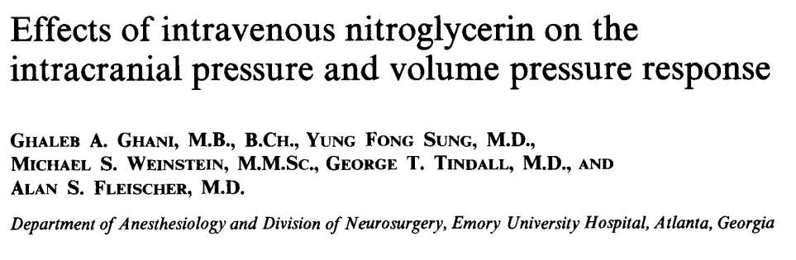
Blood pressure management in ICH
Nitroprusside and Nitroglycerin are typically avoided because they may increase intracranial pressure
References:
Management of interacerebral hemorrhage: JACC focus seminar 2019
Up to Date
Braunwald's heart disease,12th edition

Slide 42
CASE 6
42 y/o female patient with PMH of BAV and HTN , presented to the ED due acute and severe back pain.
Initial P/E :
Left hand was pulseless
Diastolic murmur in Aortic site
Right hand BP :160 /110 mmHg
Left hand BP : 140 / 95 mmHg

Slide 43
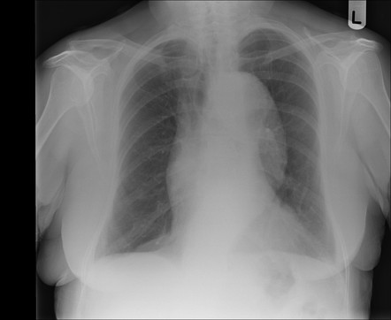

Slide 44
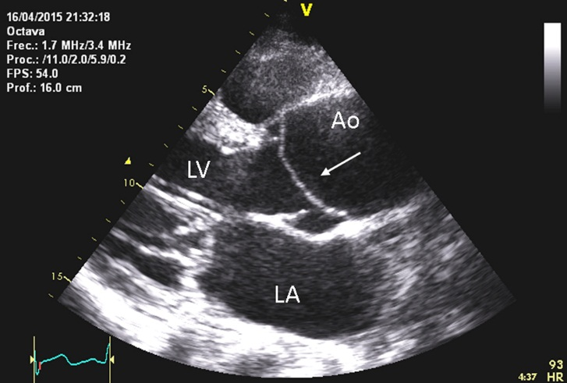

Slide 45

Acute aortic dissection
Goal SBP: 100 to 120 mmHg within 20 minutes of diagnosis .
First IV B blocker (Esmolol , Labetalol, Propranolol, Metoprolol ) → HR < 60 bpm
Then vasodilator (often Nitroprusside) is typically required to quickly achieve the goal BP.
Vasodilator therapy should not be used without first controlling heart rate with beta blockade.

Slide 46
CASE 8
35 y/o pregnant lady present with proteinuria.
BP : 170 /100 mmHg
She has no symptoms .

Slide 47
Severe HTN in pregnancy
SBP > 160
Or
DBP> 110

Slide 48
Target blood pressure
Reduce MAP by no more than 25 % over two hours to achieve target BP of 130 to 150 mmHg systolic and 80 to 100 mmHg diastolic.
DO NOT aggressively lower BP (eg, <120/80) in such cases as this may be associated with decreased uteroplacental perfusion.

Slide 49
After achieving the target blood pressure, close blood pressure monitoring should continue
For patients not in labor:
  Q10 minutes for the first hour
  Q 15 minutes for second hour
  Q 30 minutes for the third hour,
  and then Q 1hour for four hours

Slide 50
Choice of therapy
IV Labetalol or hydralazine : first-line agent

Slide 51
Labetalol
IV labetalol for first-line therapy
Asthma or maternal heart rate <50 bmp is a contraindication to use, whereas labetalol is preferred to other classes of antihypertensive drugs if the maternal heart rate >110 bmp
20 mg IV over 2 minutes followed at 10-minute intervals by doses of 20 to 80 mg up to a maximum total cumulative dose of 300 mg if BP remains above target level.
A constant infusion of 1 to 2 mg/minute

Slide 52
If labetalol alone is ineffective, switch to hydralazine.

Slide 53
Hydralazine
Begin with 5 mg IV over 1 to 2 minutes
If BP goal is not achieved within 20 minutes, give a 5 to 10 mg bolus
The fall in blood pressure begins within 10 to 30 minutes and lasts from two to four hours.
If a total cumulative dose of 20 to 30 mg per treatment event does not achieve optimal blood pressure control or heart rate exceeds 100 beats/minute, another agent should be used.

Slide 54
CASE 9
54 y/o male patient presented to the ED due to headache and high blood pressure. He was otherwise asymptomatic.
His initial BP was 210/130 mmHg
  Fundoscopy : Normal

Slide 55
Hypertension urgency
SBP ≥180 mmHg and/or DBP ≥120 mmHg
Asymptomatic
Mild headache can be present

Slide 56
Admit or follow up?
Admit :
High risk for acute cardiovascular events (eg, longstanding DM , known CAD or prior stroke)
Ideally : observed for a few hours to ascertain:
BP is stable or improving,
indeed remain asymptomatic
Then patient can be sent home with close follow-up

Slide 57
Blood pressure reduction goal
Shorter-term goal reduce BP ≤160/≤100 mmHg.
However, MAP should not be lowered by more than 25 to 30
% over the first several hours

Slide 58
Therapeutic strategies
Quiet room in which to rest.
30 min rest → fall in BP ≥20/10 mmHg in 32 %
If this is not effective, antihypertensive drugs may be given.
2. If high risk for imminent cardiovascular events due to severe HTN : known aortic or intracranial aneurysms, should have their BP lowered over a period of hours.

Slide 59
Rapid and aggressive antihypertensive therapy can induce cerebral or myocardial ischemia or infarction, or acute kidney injury, if the BP falls below the range at which tissue perfusion can be maintained by autoregulation
Mostly with sublingual nifedipine, due to an unpredictable and uncontrolled BP reduction as well as severe ischemic complications

Slide 60
Choices
Oral
Captopril
Amlodipine
Hydralazine
follow-up visit in the next one to two days.

Slide 61
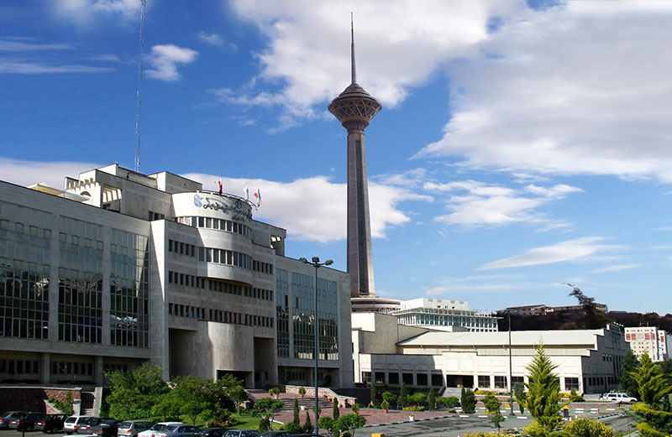
Thanks for your attention

